Slide 1

Deep Dive Into Co-Development
Norman Bier
Associate Director, Open Learning Initiative

Slide 2
Outcomes
Accurately describe co-development opportunities to your project team and consortia.
List likely co-development content areas and identify potential areas of overlap with your project.
Describe benefits and tradeoffs of Co-development.
Relate co-development to other OPEN opportunities.
Identify next steps for co-development participation.

Slide 3
Agenda
Introduction
What is OLI?
What is Co-development?
Getting Involved
The Co-Development Process
Next Steps
Discussion

Slide 4
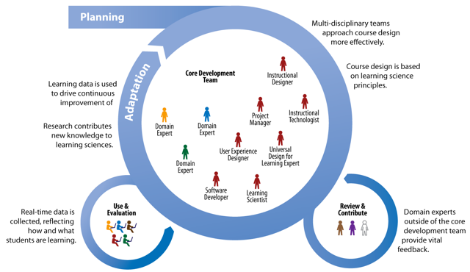
Co-development?

Slide 5
Co-development?
Subject matter experts from multiple institution/grantees
CAST: UDL and Student Variability
OLI: Applied Learning Science, HCI, Instructional Design and Technology, Platform, Data and Analytics
Collaborative Design and Development of Online Learning Environment
Data-driven, Iterative Improvement
Use and Evaluation—multiple grantees and beyond

Slide 6
What is the Open Learning Initiative?
?

Slide 7
An approach to designing, developing, delivering and improving learning experiences
Science
Technology
Teams
Data
Science of Learning
Evaluation
Improvement
Platform
In-course Affordances
Team-based Development
Communities of Research and Use
Capture
In-course Use
Iterative Improvement
Research

Slide 8
Which problem type is most difficult for beginning algebra students?
Story Problem
As a waiter, Ted gets $6 per hour. One night he made $66 in tips and earned a total of $81.90. How many hours did Ted work?
Word Problem
Starting with some number, if I multiply it by 6 and then add 66, I get 81.90. What number did I start with?
Equation
x * 6 + 66 = 81.90

Slide 9
Algebra Student Results: Story Problems are Easier!

Slide 10
Algebra Student Results: Story Problems are Easier!
Nathan, M.J. & Koedinger, K.R. (2000). Teacher’s and researchers beliefs of early algebra development. Journal of Mathematics Education Research, 31(2), 168-190

Slide 11
Why a learner-centered approach?
Learning results from what the student does and thinks and only from what the student does and thinks. The teacher can advance learning only by influencing what the student does to learn.
Herbert Simon, 2001
It’s not teaching that causes learning. Attempts by the learner to perform cause learning, dependent upon the quality of feedback and opportunities to use it.
Grant Wiggins
President, Center of Learning Assessment
Notes:
Focus is on learning, not teaching
Allows for application of science

Slide 12
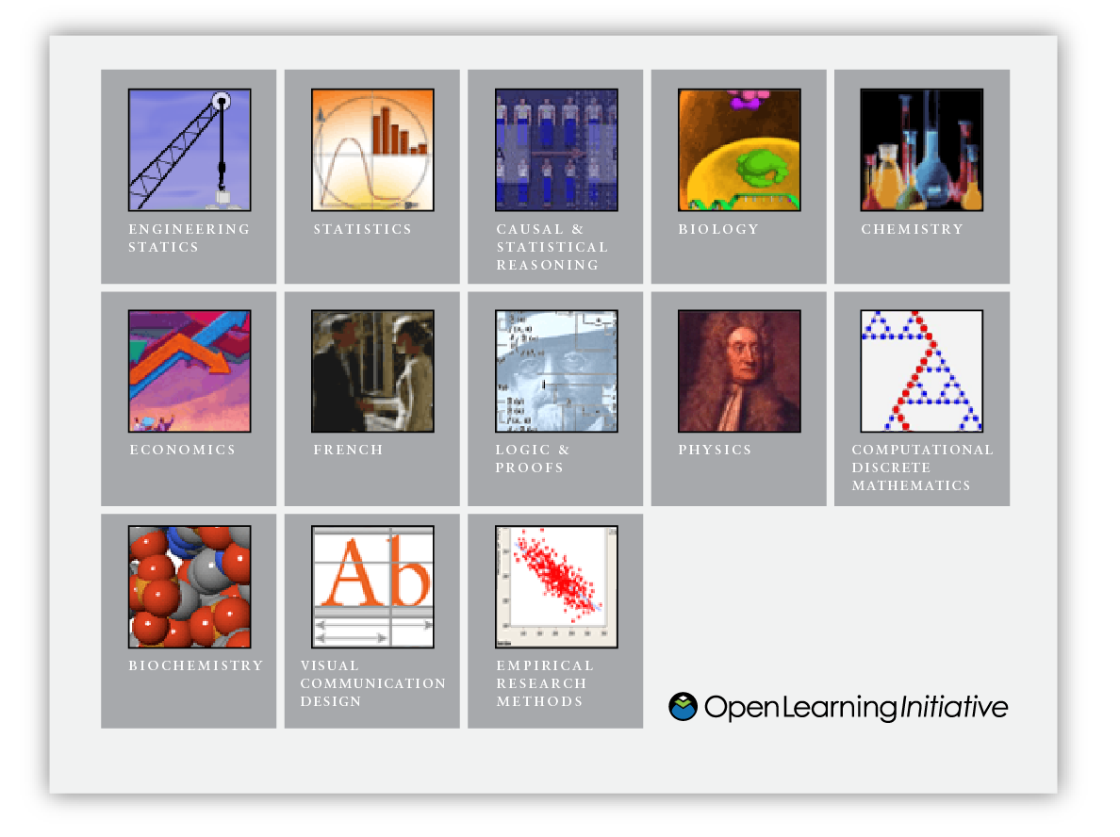
What is CMU’s Open Learning Initiative?
Scientifically-based online learning environments designed to improve both quality and productivity in higher education

Slide 13

A little history…

Slide 14

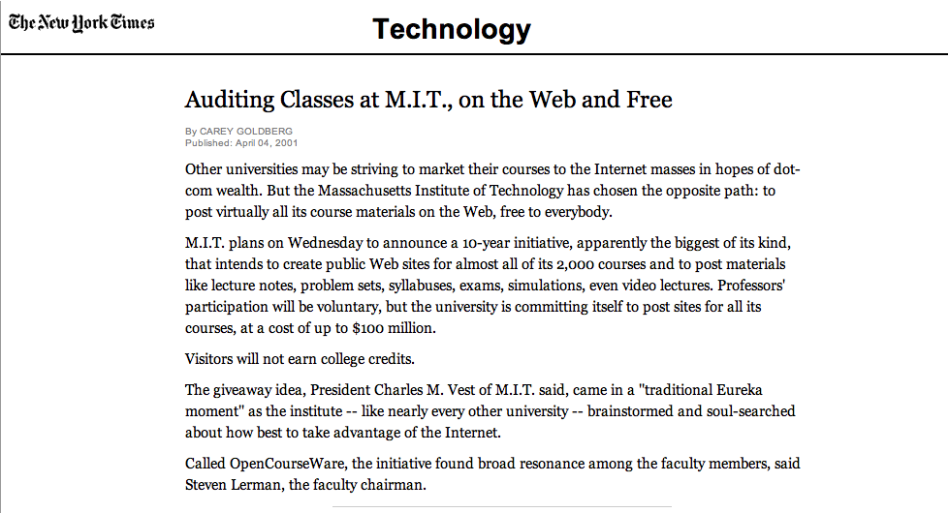
Open Education

Slide 15

Inception
Access and Evaluation
CMU Strengths
Enacting Instruction
Evidence-based, Computer-assisted Online Learning

Slide 16
OLI Goals
Produce and improve exemplars of scientifically-based online courses and course materials that enact instruction and support instructors
Provide open access to these courses and materials
Develop a community of use, research & development that contributes to the evaluation, continuous improvement, and ongoing growth of the courses and materials.

Slide 17
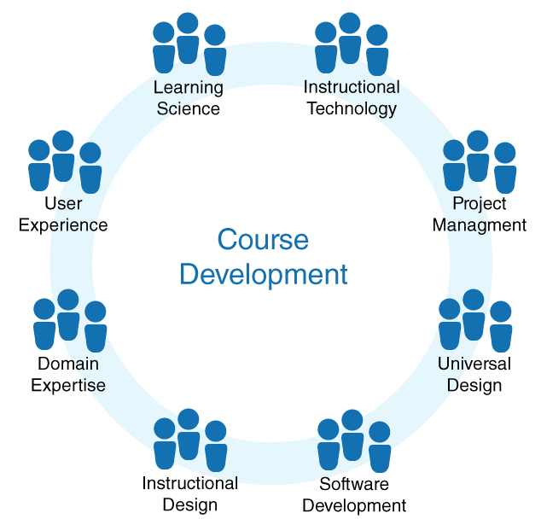
Team-based design and development

Slide 18
Community-based Research

Slide 19
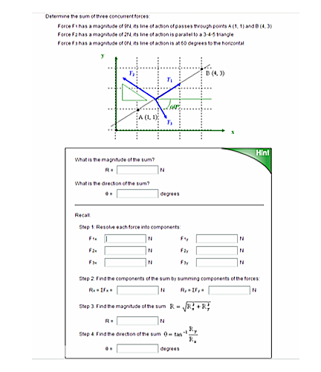
Principles Derived from Learning Science
Goal directed practice and targeted feedback are critical to learning
Learners receive support in the problem-solving context

Slide 20
What is a Cognitive Tutor?
A computerized learning environment whose design is based on cognitive principles and whose interaction with students is based on that of a (human) tutor—i.e., making comments when the student errs, answering questions about what to do next, and maintaining a low profile when the student is performing well.

Slide 21
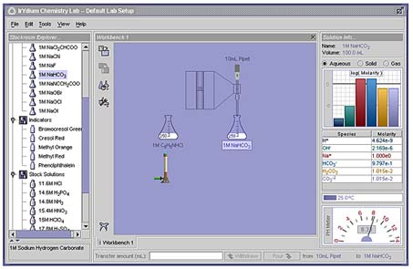
Principles Derived from Learning Science: Practice Synthesizing and Applying Skills & Knowledge

Slide 22
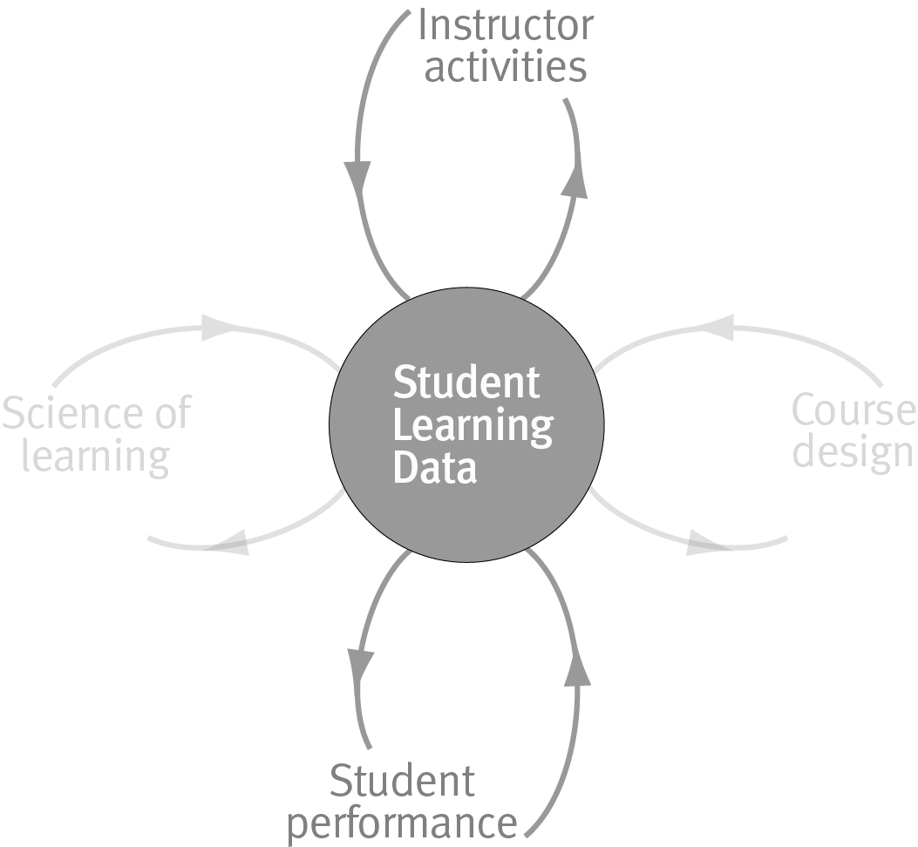
Feedback: Changing the Productivity of Learners and Teachers

Slide 23
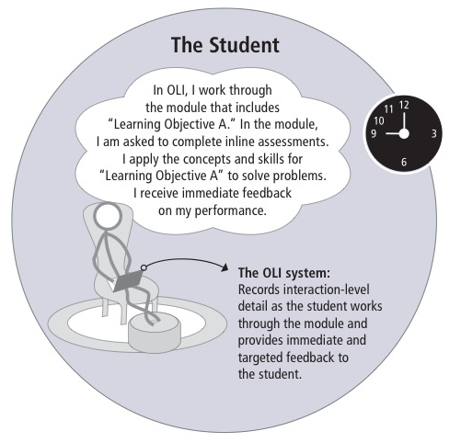

Slide 24
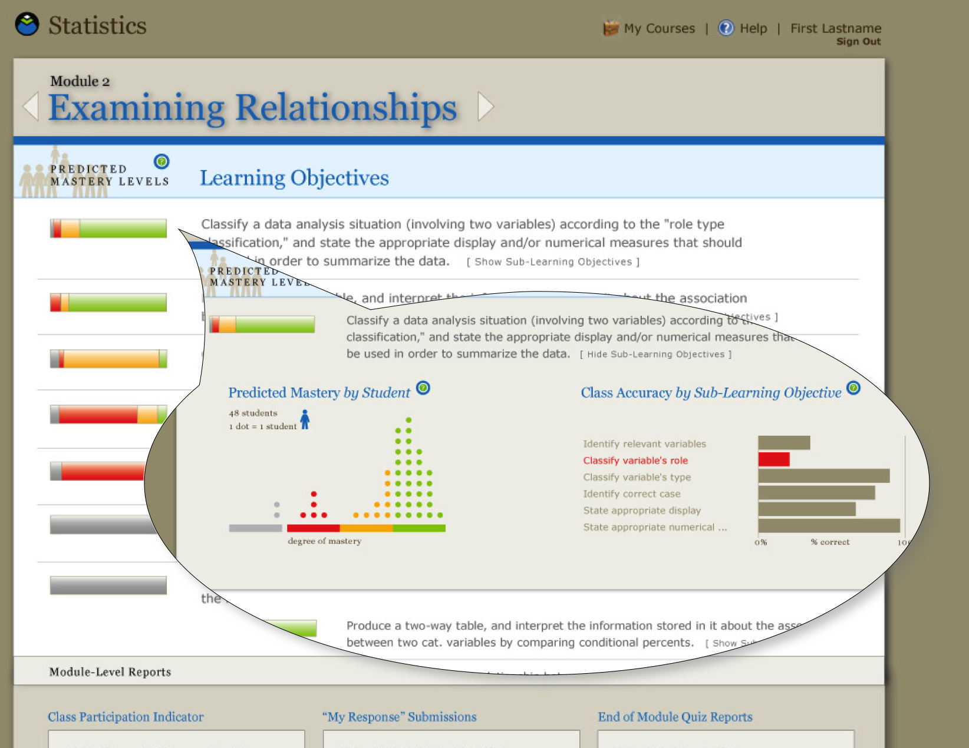

Slide 25
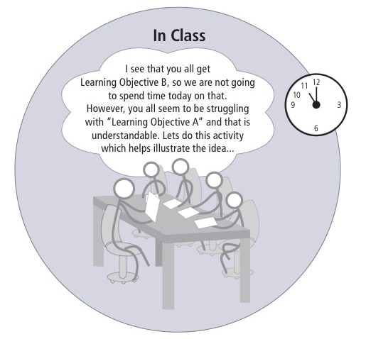

Slide 26

Feedback Loops for Continuous Improvement

Slide 27
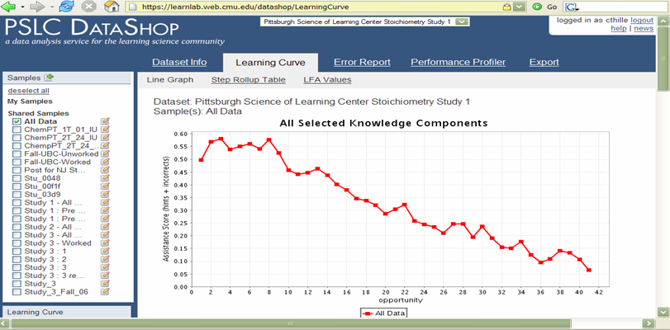
Learning Curve Analysis
DataShop: Pittsburgh Science of Learning Center

Slide 28
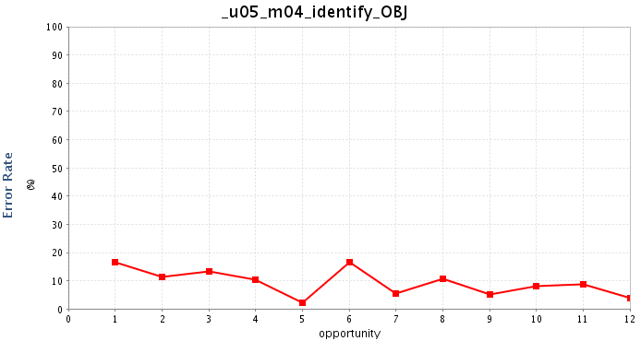
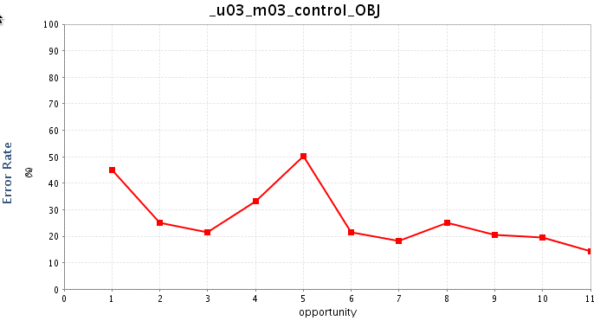
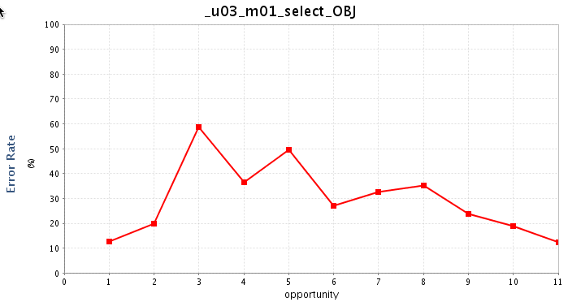
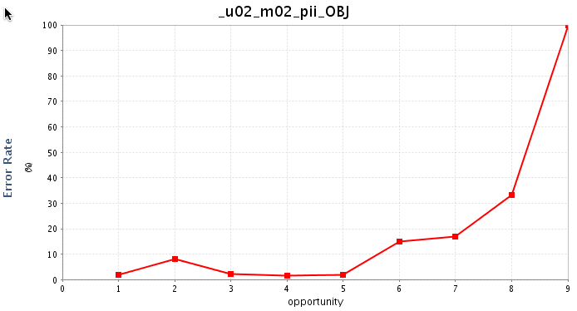
Other Learning Curves learnig
DataShop: Pittsburgh Science of Learning Center

Slide 30
Other Metrics
 | Engaged |  | Didn’t Engage
College | Pass | Fail | Pass | Fail
CFA | 87% | 13% | 36% | 64%
CIT | 98% | 2% | 81% | 19%
CMU | 100% | 0% | 67% | 33%
HSS | 98% | 1% | 58% | 42%
MCS | 96% | 4% | 75% | 25%
SCS | 99% | 1% | 83% | 17%
TSB | 98% | 2% | 69% | 31%
Total | 96% | 4% | 67% | 33%

Slide 31
OLI Review:
Apply learning science research and scientific method to course development, implementation and evaluation.
Develop interactive learning environments collaboratively (teams of content experts and novices, learning scientists, HCI, software engineers).
Feedback loops for continuous improvement.
Communities of use, evaluation and improvement.

Slide 32
What is Co-development?
?

Slide 33
Co-development
An instantiation of this scientific, team-based approach in the TAACCT Context:
Identify broadly applicable subject area from grant proposals.
Identify potential participating consortia.
Create a development team and:
Design
Deliver
Evaluate
Improve

Slide 34
Grantee Participation
Consortia
Role
Lead Grantee
Grantees in Domain
Other Grantees
Lead Course Author
Review and Contribute
Use and Evaluate

Slide 35
Roles
CAST and OPEN
Grantees
Project Management
UDL
Learner Variability
Learning Science / Design
Technology
HCI
Data Analytics
Subject Matter Experts
Industry / Domain Guidance
Standards
Learner Context

Slide 36
Key:
We design and develop a learning environment.
Notes:
All of us (not just us on stage)
Team-based
Radical departure from traditional model (esp. at 4 years, but even at cc)

Slide 37
“Improvement in Post Secondary Education will require converting teaching from a ‘solo sport’ to a community based research activity.”
—Herbert Simon

Slide 38
In Relation to Other OPEN/TAACCCT Opportunities:
Open Services (all projects)
Platform+ (25 projects)
Co-development (3 teams)
Notes:
Open Services: best practices but also existing open course ware (including OLI courses)
One could imagine this existing independently (each serving an independent project)
As we walked through this process with our funders, however, it became clear that we might be able to do something more interesting by creating opportunities to engage in these tiers at multiple levels
One of the best parts of working with courses is learning stuff outside domain. Who knows concept of emergent properties?

Slide 39
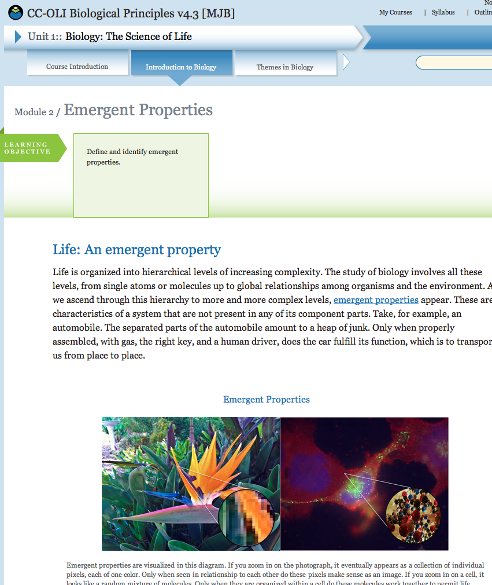
Emergent Properties
Characteristics of a system that do not appear in any one of its component parts alone, but that appear when all parts are combined

Slide 40
Engaging at Multiple Levels
Be part of a co-development team
Additional involvement in platform+
Use of existing courses and assets
Notes:
Co-dev: author, review, contribute, use evaluate
Platform+: create own course, potentially use others’ work
OLI and other pre-existing courseware that might already fill niche

Slide 41
Engaging at Multiple Levels:
Builds Capacity
Leverages Strength of Scientific Approach Across Programs
Reuse: Efficiency and Effectiveness
A Virtuous Cycle
Data
Theory
EdTech

Slide 42
Getting Involved
?

Slide 43
Our Approach
Review Proposals
Conversations with Grantees
Selection of Subject Areas
Discussions with Potential ‘Lead Grantees’
Call for Participation
Project Launch
Notes:
Review proposals
Consider overlap and breadth of subject matter
Consider how well prepared consortia are to engage in effort
Standards based
Centralized vs. distributed
Prep work
Amiable to OLI/CAST approach
Conversations with grantees
Better understanding of consortia and plans
Exploration of timeline
Other requirements
Selection of subject areas
Discussion with potential ‘lead’ institutions
What is ‘lead institution’
Not in charge, still team effort
Helps to define scope
Probably provides lead author
Probably the decider when necessary
Commitment to engage throughout process

Slide 44
Subject Areas
STEM Readiness
Healthcare
Manufacturing (?)
IT (?)
Notes:
In order of possible launch
Manufacturing still uncertain
Broad applicability key
Also, only one course….

Slide 45
Ways to Be Involved:
Core Authoring:
SME
Faculty
Review and Contribute Members:
SME
Faculty
Industry/Professional Groups
Administration
Use and Evaluate
Technologists
Administration

Slide 46
Timeline for Projects (months)
O-1: Initiation
2-3: Planning
4-7: Initial Modules
8-12: Continued Development and Piloting
13-15: Final Development and Release
15-18: Evaluation and Improvement

Slide 47
Planning and Training
Recruiting
Training Workshop
Scope
Big Picture and Conceptual Framework
Draft Learning Outcomes

Slide 48


A Change in Knowledge State
?
!

Slide 49
Development The Course Design Triangle
Objectives
Descriptions of what students should be able to do at the end of the course
Assessments
Tasks that provide feedback on students’ knowledge and skills
Instructional Activities
Contexts and activities that foster students’ active engagement in learning

Slide 50
Use and Evaluation
Qualitative Feedback
Quantitative Data
Live Courses
Student Feedback
Instructor Feedback
Development Team

Slide 51
Next Steps
If interested, get in touch!
Contact Information
Subject Area(s)
Services
Timeline
Email OR http://open4us.org/services/

Slide 52
Learn More

Slide 53
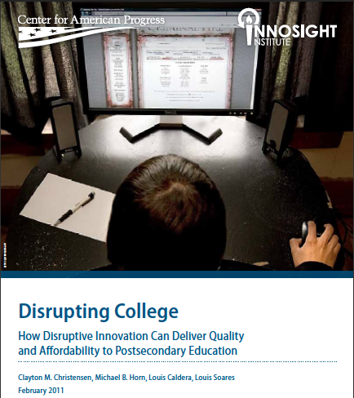
“Changing circumstances mandate that we shift the focus of higher education policy away from how to enable more students to afford higher education to how we can make a quality postsecondary education affordable.” - Clayton Christensen

Slide 54
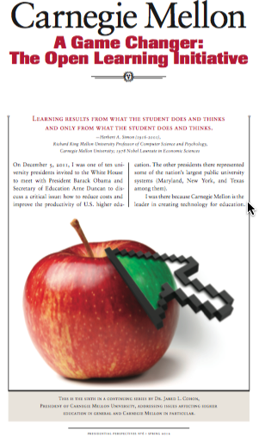
I was one of ten university presidents invited to the White House to meet with President Barack Obama and Secretary of Education Arne Duncan to dis- cuss a critical issue: how to reduce costs and improve the productivity of U.S. higher education. The other presidents there represented some of the nation’s largest public university systems (Maryland, New York, and Texas among them). I was there because Carnegie Mellon is the leader in creating technology for education. -Dr. Jared L. Cohen

Slide 55

Not only is there a need to seek entirely new approaches, insights and models, but that need is urgent. New approaches offer scalable processes that help colleges lower cost-per-degree and make significant improvements to student learning outcomes and retention rates. Insights from the science of learning combined with advances in information technology and alternative models of course design, implementation, and evaluation show promise in supporting traditional higher education to change the production function and meet the seemingly impossible challenge. -Candace Thille, Director OLI

Slide 56
• Can sophisticated, interactive online courses be used to maintain or improve basic learning outcomes (mastery of course content, completion rates, and time-to-degree) in introductory courses in basic subjects such as statistics? • Are these courses as effective, or possibly more effective, for minority and low-socioeconomic-status students and for other groups subject to stereotype threat? Or, are these groups less well suited to an online approach? • Are such courses equally effective with not-so-well-prepared students and well-prepared students? The results of this study are remarkable; they show comparable learning outcomes for this basic course, with a promise of cost savings and productivity gains over time. DEANNA MARCUM Managing Director, Ithaka S+R

Slide 57
Discussion
Accurately describe co-development opportunities to your project team and consortia.
List likely co-development content areas and identify potential areas of overlap with your project.
Describe benefits and tradeoffs of Co-development.
Relate co-development to other OPEN opportunities.
Identify next steps for co-development participation.

Slide 58
Beyond Courses

Slide 59


Gaps between supply and demand for effective post-secondary education are growing

Slide 60
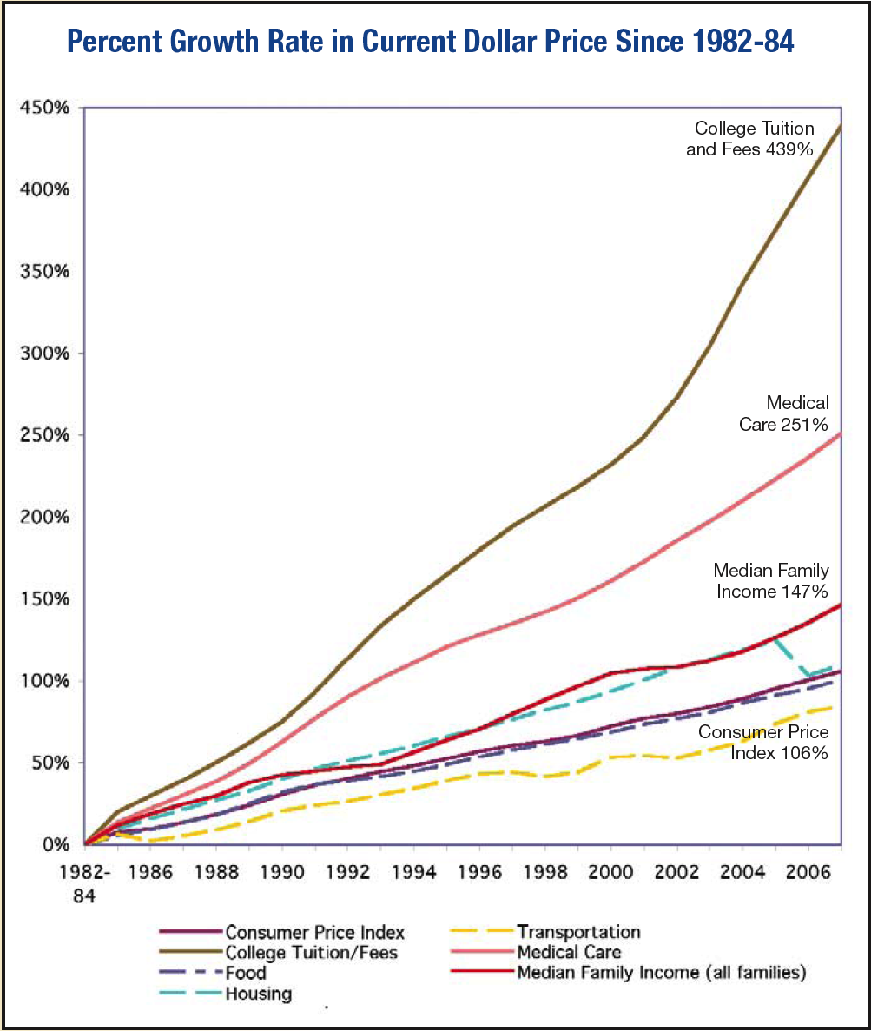
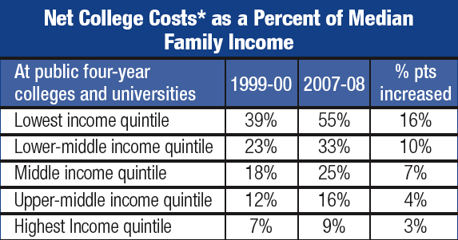
Cost relative to median family income
Source: “Measuring Up 2008”

Slide 61


One Complexity for Instructional Productivity: Baumol’s “Cost Disease”
“A half hour horn quintet calls for the expenditure of 2.5- man hours in its performance, and any attempt to increase productivity here is likely to be viewed with concern by critics and audience alike.” (1967)

Slide 62
A false dichotomy for post-secondary education
Low Quality, Hi Productivity | Hi Quality, Hi Productivity
Low Quality, Low Productivity | Hi Quality, Low Productivity
Many, with Baumol assume higher education has only these two options
Productivity
Quality

Slide 63

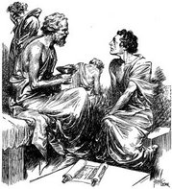
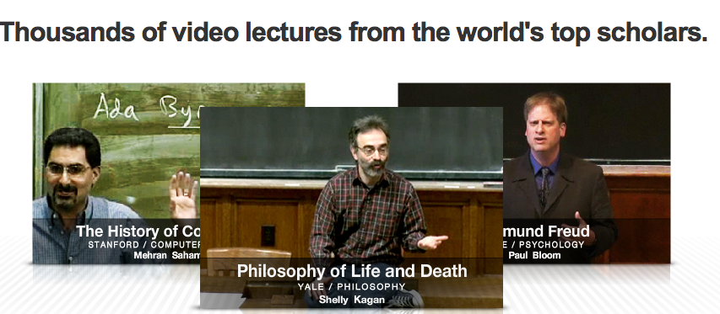

Slide 64
Questions? Discussion?
Norman Bier
nbier@cmu.edu

